Slide 1

Financial and risk analytics capstone project
Stock Analysis and Advice
By
Yash Luharuka

Slide 2
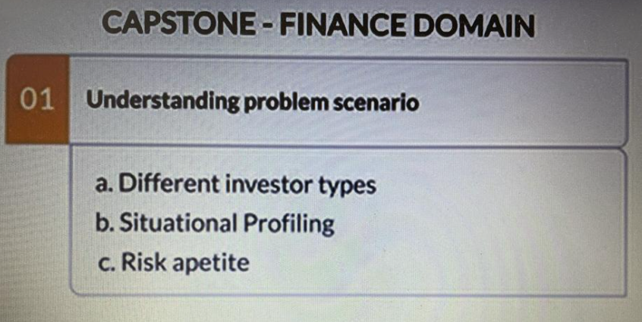
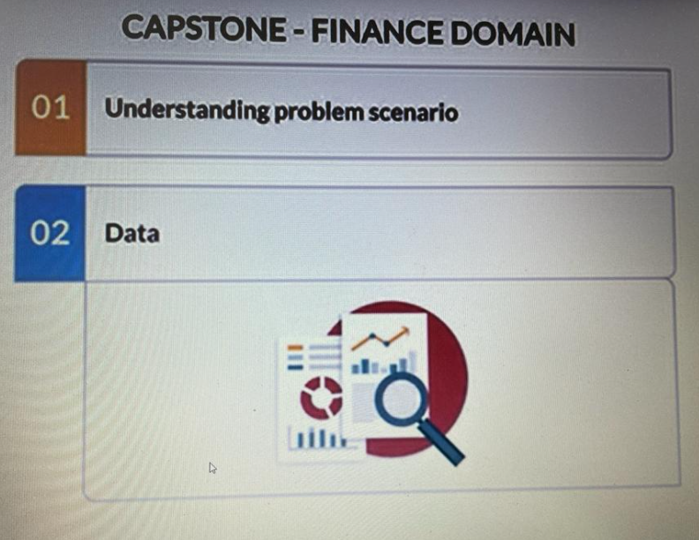
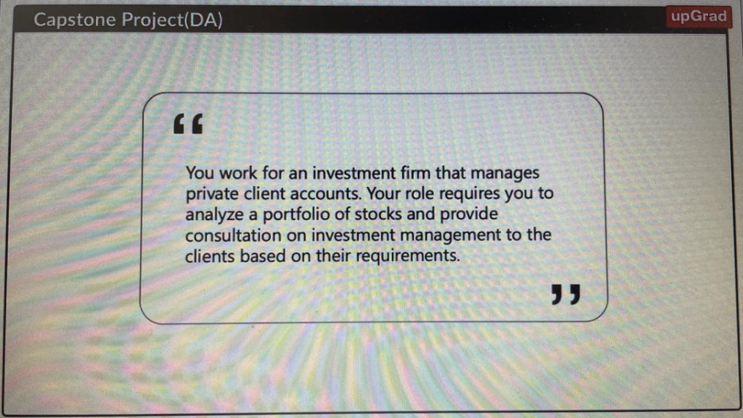
Capstone requisites

Slide 3
Business CASE
In the recent past, the industry of wealth management has seen a lot of growth. Every individual or business actively searches for opportunities to get the maximum returns. However, in most of the cases, they either lack the skills to identify the right investment opportunity, or there is a shortage of time for finding these opportunities. Hence, this gave rise to the dedicated individuals who perform this task on behalf of the investors for a commission - Portfolio managers
A portfolio manager makes investment decisions and carries out other related activities on behalf of vested investors. They work with a team of analysts and researchers, and their main objective is to realise the needs of the investor and suggest a suitable portfolio that meets all the expectations. They are responsible for establishing the best investment strategy, selecting appropriate investments along with the right allocation. However, in doing so, they face a lot of competition in the form of other portfolio managers and rival firms. Therefore, the portfolio manager has to use the available resources to provide the best solution to the investor
Consider yourself working for an associate at an investment firm that manages accounts for private clients. Your role requires you to analyse a portfolio of stocks to provide consultation on investment management based on client’s requirement. Let us hear more about it from Joydeep as he introduces you to the entire case.

Slide 4
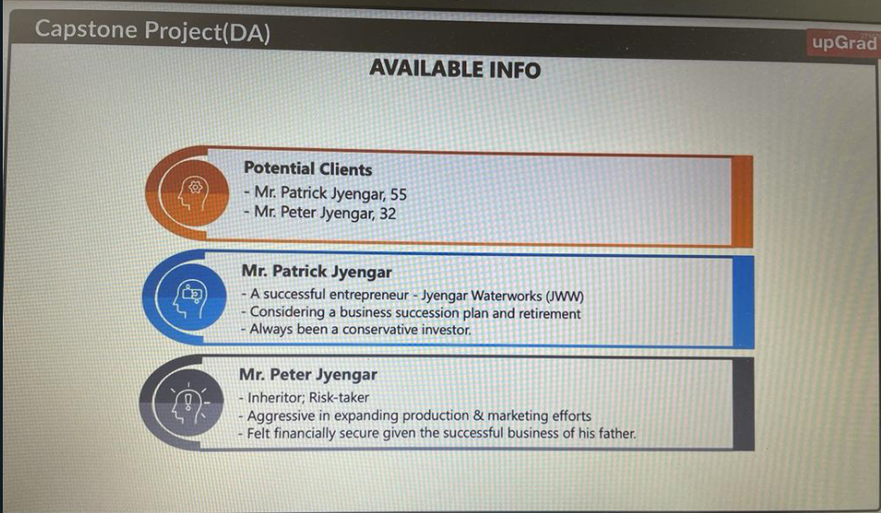
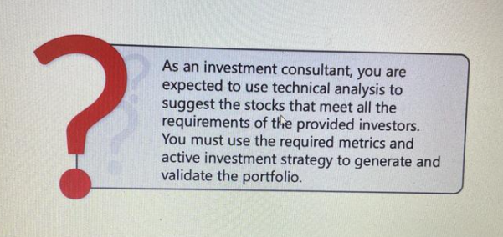
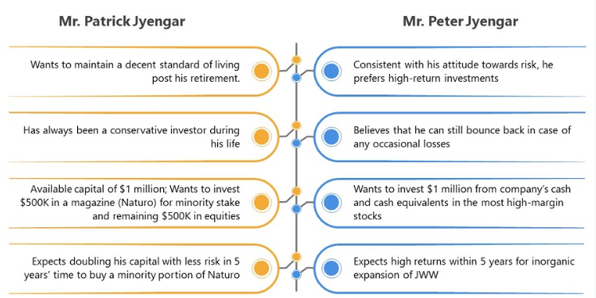
Information available
Your task is to provide consultation to two different investors, Mr Patrick Jyenger and Mr Peter Jyenger based on their requirements and financial objectives. You can refer to the elements mentioned in the video to develop the investor persona. The image below summarises the profile of the two investors:

Slide 5
Data Description
provided with the following information for 24 stocks of leading companies listed in New York Stock Exchange(NYSE):
Date
Open price: Price of stock at the start of the day
Close price: Price of stock at the end of the day
High price: Highest price reached by the stock on that day
Low price: Lowest price reached by the stock on that day
Adjusted close price: Stock price adjusted to include the annual returns (dividends) that the company offers to the shareholders
Volume traded: Number of stocks traded on the day
The information for every stock ranges from 1st October 2010 to 30th September 2020.
The stocks belong to different domains:
Technology/IT
Travel/Aviation/Hospitality
Banking/Financial Services and Insurance
Pharmaceuticals/Healthcare/Life Sciences
To help you with the market benchmark, you are given the S&P 500 index prices for the same period.

Slide 6
Contents
Data Loading
Data Exploration
Stock Analysis and Portfolio Management
Reporting

Slide 7
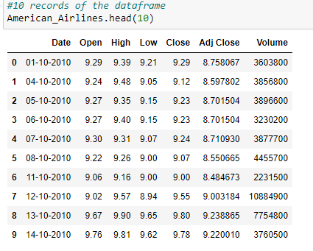
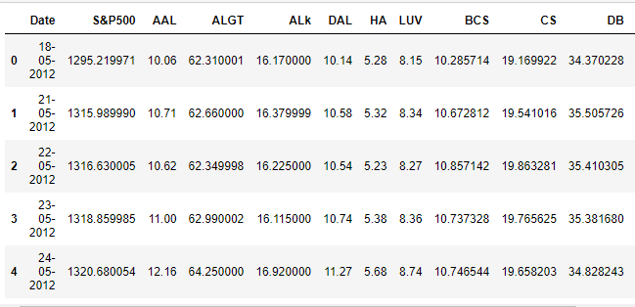
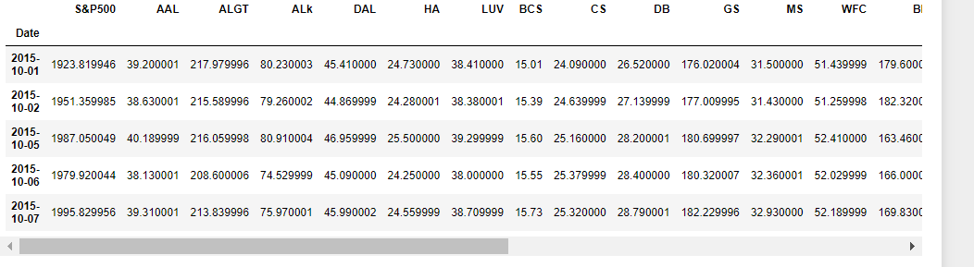
Data Loading
This included several steps starting from importing Libraries
Followed by loading/Importing 25 different CSV Files.
After which the steps of Merging them in one excel/csv file took place. Leading to complete data cleaning
Daily Stock Price
Closing Price of Stock
Data Processing steps of renaming, appending, and the rest
Creation of new subsets that led to merging followed by inspection of the data frame and data cleaning.
Removal of null values
Leading to Final_Cleaned_Dataset.CSV

Slide 8
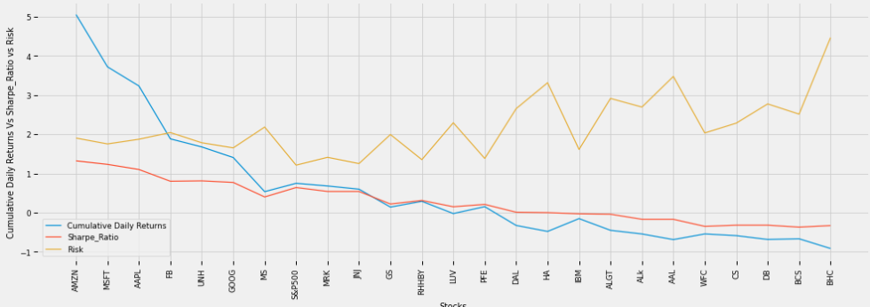
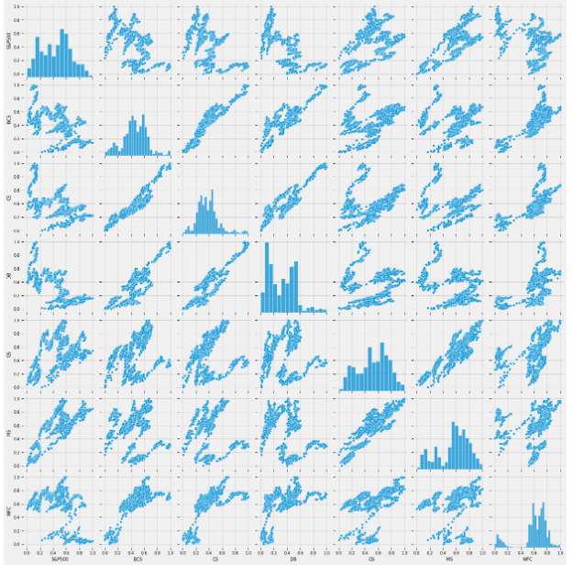
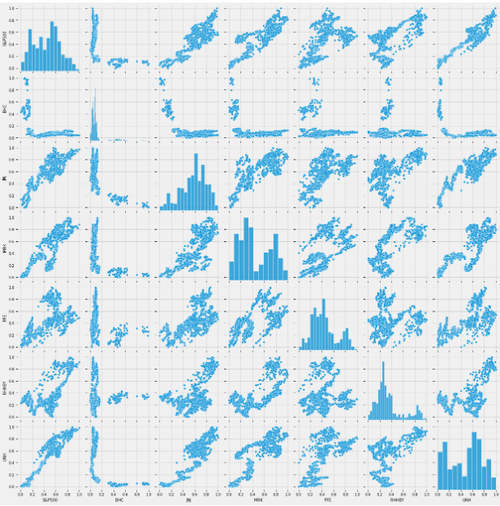
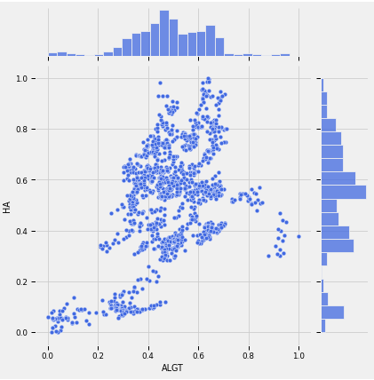
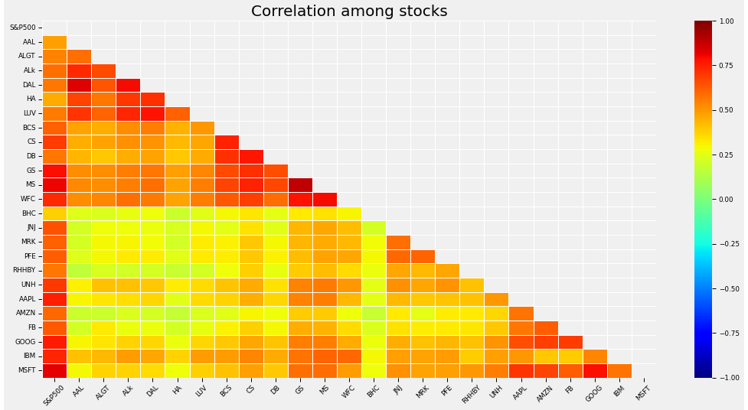
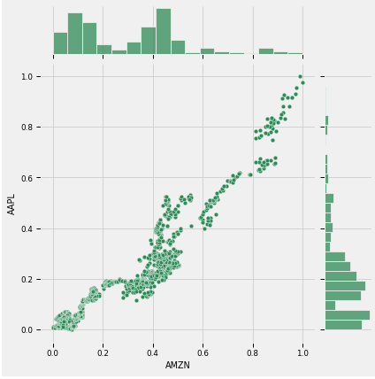
Data exploration
Creation of Several visualizations
Stock price comparison in Aviation, financial, pharma, and technological sector
Correlation of several stocks
Performed calculation metrics of the following
Risk/Volatility
Daily Returns
Cumulative Returns
Sharpe Ratio
Aviation Industry Pearson coefficient = 0.47
Technological Industry Pearson coefficient = 0.94
Microsoft & Google stocks are highly correlated in the Technology Stocks Goldman Sachs, Morgan Stanley & WellsFargo are correlated in the Finance Stocks American Airlines & Delta Airlines are more correlated than Alaska Air Group in the Aviation stocks Pharma stocks are less correlated when compared to any other sector stocks

Slide 9
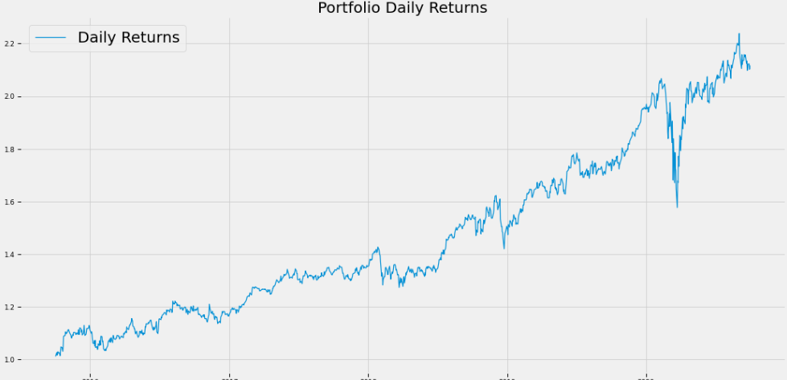
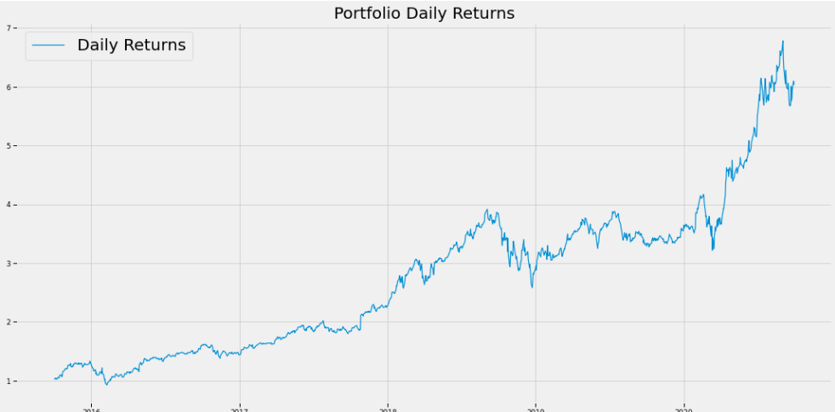
Stock Analysis and Portfolio Management
SHARP RATIO
We have looked at the daily Return of stock.We have done correlation between the stock prices.Microsoft and Amazon have highest daily price correlation.maximum daily fluctuation in ths stock is 8 % .In stock exchange there is a limit on per day fluctuation of stock.So if the stock reaches the threshold value then the trading of the stock is stopped for that day.

Slide 10
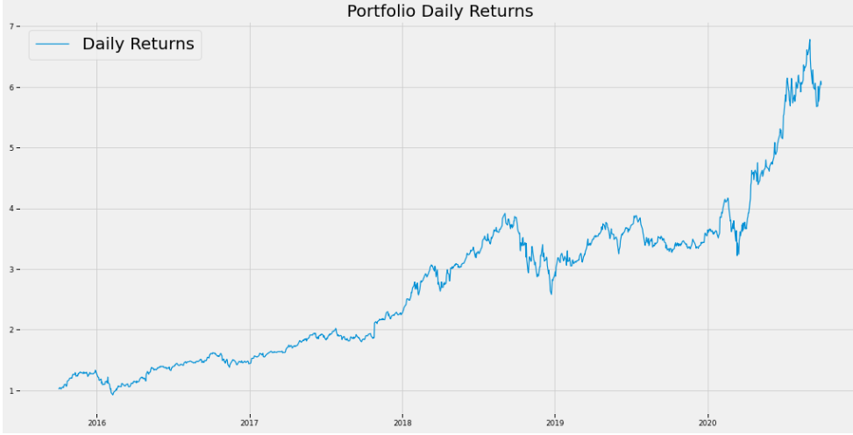
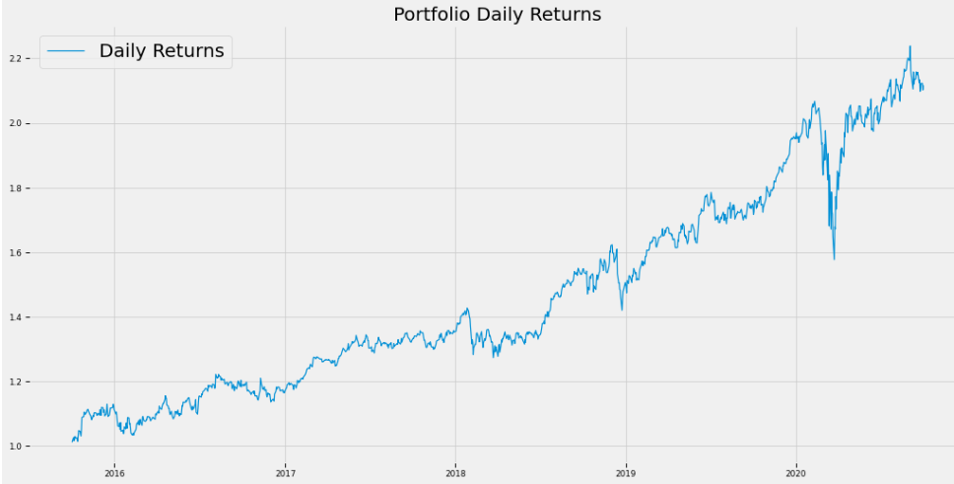
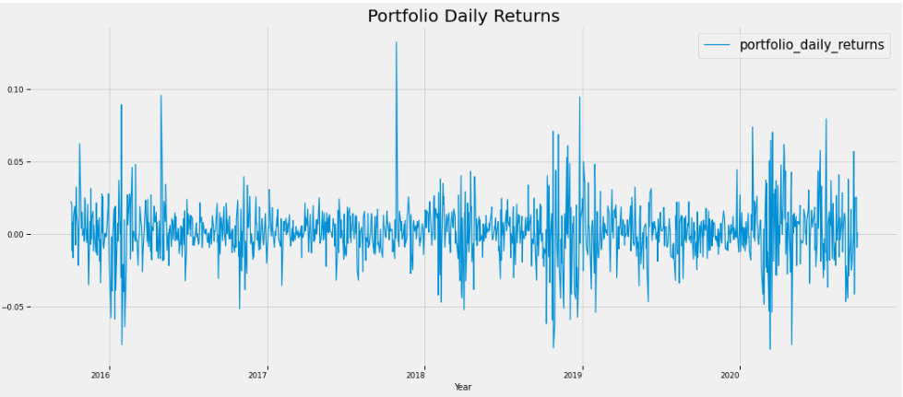
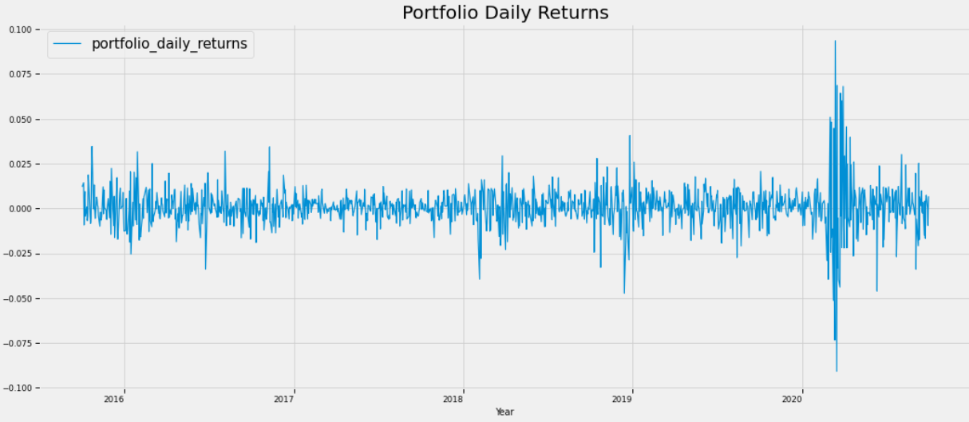
REPORTING
In this Notebook we have explored stock prices of tech stocks, pharma stocks, Aviation stocks, finance stocks & market Index also. We have looked at the historical price of stock price.We have looked at the volume of stock traded.
We have looked at the daily Return of stock.We have done correlation between the stock prices. Microsoft and Amazon have highest daily price correlation.maximum daily fluctuation in ths stock is 8 % .In stock exchange there is a limit on per day fluctuation of stock.So if the stock reaches the threshold value then the trading of the stock is stopped for that day.
Stock with Low risk and high return are the best stock to buy. We can see that Amazon Stock has high risk and high returns.
Total ROI is 6046877.6988774445
Mr.Peter jyengar invests 1 Million Dollar on equities i.e the above Portfolio. Returns that he would fetch after 5 years is more than 6 Million Dollars with 5+ Million dollars of gain

